Slide 1
1) What is the difference between JDK and JRE?
JDK(Java Development Kit) is used to develop Java applications. JRE(Java Runtime Environment) is the implementation of JVM(Java Virtual Machine). JDK is mainly used for the execution of code and its main functionality is development. JRE is mainly used for creating an environment for code execution. JDK contains tools which are required for development and debugging purpose. JRE contains class libraries and supporting files required for the purpose of execution of the program.

Slide 2
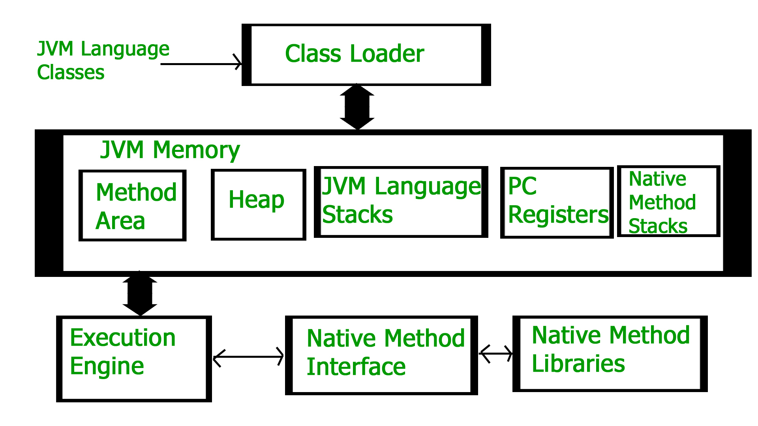
2) What is Java Virtual Machine (JVM)?
A Java virtual machine (JVM) is a virtual machine that enables a computer to run Java programs as well as programs written in other languages that are also compiled to Java bytecode. The Java virtual machine is an abstract (virtual) computer defined by a specification. It is a part of java runtime environment.
JVM Architecture

Slide 3
3) What are the different types of memory areas allocated by JVM?
Different types of memory areas allocated by JVM are as follows:
Class(Method) Area
Heap
Stack
Program Counter Register
Native Method Stack

Slide 4
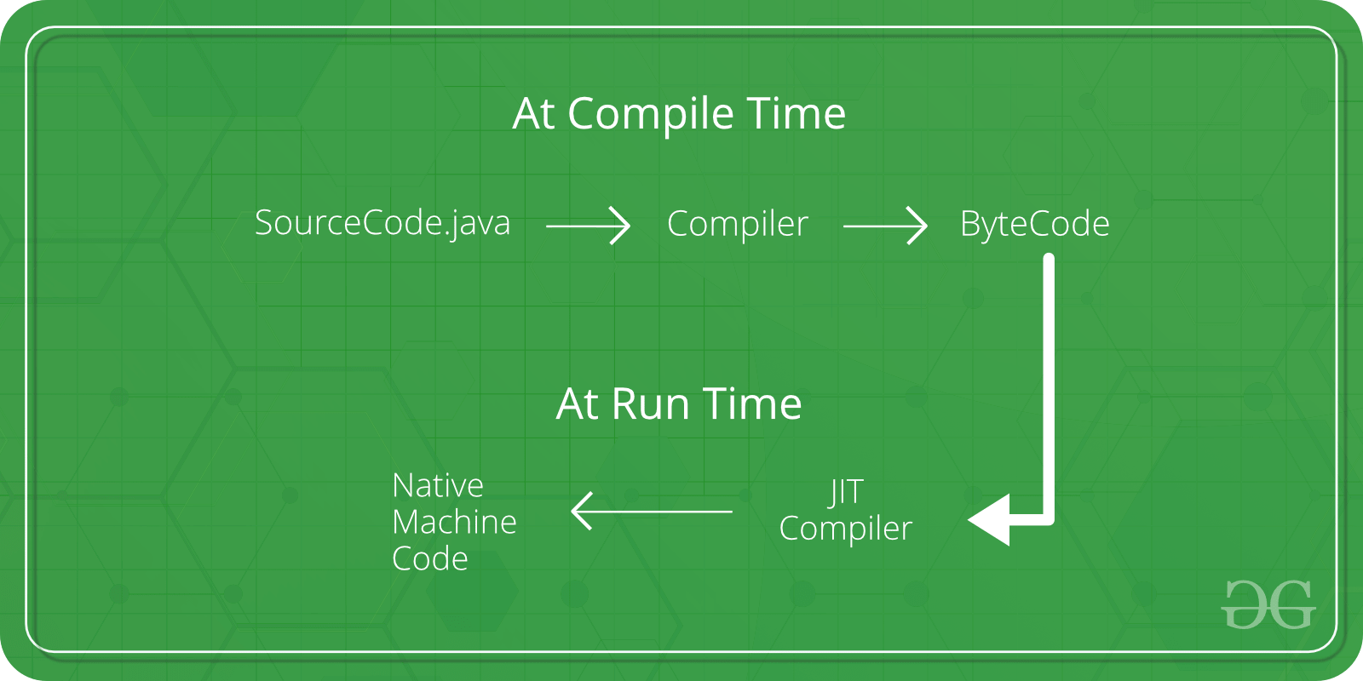
4) What is JIT compiler?
A just-in-time (JIT) compiler is a program that turns bytecode into instructions that can be sent directly
to a computer's processor (CPU). JIT compilers contrast different compiler types such as a traditional
compiler, which will compile all code to a machine language before a program starts to run.
Execution of JIT compiler

Slide 5
5) How java platform is different from other platforms?
Java supports WORA(Write Once Read Anywhere) which means we can write java code in one platform
and run it in different platform.
We can develop java code in any operating system.
It has its own runtime environment i.e., JRE (Java runtime Environment)

Slide 6
6) Why do people say Java is “Write one run anywhere” language?
This is because we can write java code in one platform and run it in different platform.

Slide 7
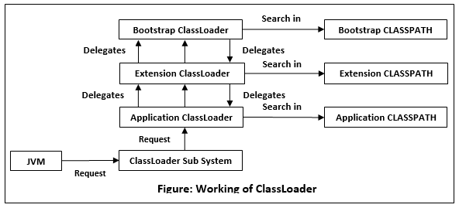
7) How does ClassLoader work in Java?
Java ClassLoader is an abstract class. It belongs to a java.lang package.It loads classes from different resources.
Java ClassLoader is used to load the classes at run time.

Slide 8
8) Do you think “main” used for main method is a keyword in Java?
No, it is not a Keyword because it is a method in java. It is the staring point for JVM to start the execution of the code.

Slide 9
9) Can we write main method as public void static instead of public static void?
Yes, we can write it that way. The compiler won’t throw any error.

Slide 10
10) In Java, if we do not specify any value for local variables, then what will be the default values for the variable?
The default value for the local variable in Java is NULL.

Slide 11
11) Let say, we run a java class without passing any arguments. What will be value of the string array of arguments in
Main method?
The value will be Empty.

Slide 12
What is the difference between byte and char data types in Java?
Byte stores binary data whereas char stores text data. Byte takes 1 Byte of space and Char takes 2 Bytes of space.

